Slide 1
Version control: Git & GitHub/GitLab
DSOR Short Course
Sept 2022

Slide 2
Lesson objectives
Understand the value of version control software.
Use Git for basic version control operations.
Sync changes to a remote repository using GitHub.
Notes:
Using GitHub for in-class activities avoids needing CAC reader for GitLab account creation

Slide 3
Version control: Git & GitHub/GitLab
What is version control? Why use it?
Git & GitHub/GitLab
Hands-on activities

Slide 4
Version control is a system that records changes to files over time, enables recall later
Everyone’s favorite VCS:
- Thesis_ver_1.docx
- Thesis_ver_2.docx
- …
- Thesis_ver_9_final.docx
- Thesis_ver_9_with_edits.docx
- Thesis_ver_9_final_final.docx
- Thesis_final_version_submitted!.docx
Notes:
Def: https://git-scm.com/book/en/v2/Getting-Started-About-Version-Control
This filename-based VC is simple & *works*, but it’s not great. Makes it easy to overwrite files by mistake, poor documentation (what makes it ver 5?) and very poor if working with multiple files that also have multiple versions. Let’s find a better way.

Slide 5

Better: local version control system (VCS)
Revision history lives in a database
You only work on a file with a constant name
Notes:
Image: https://git-scm.com/book/en/v2/Getting-Started-About-Version-Control

Slide 6
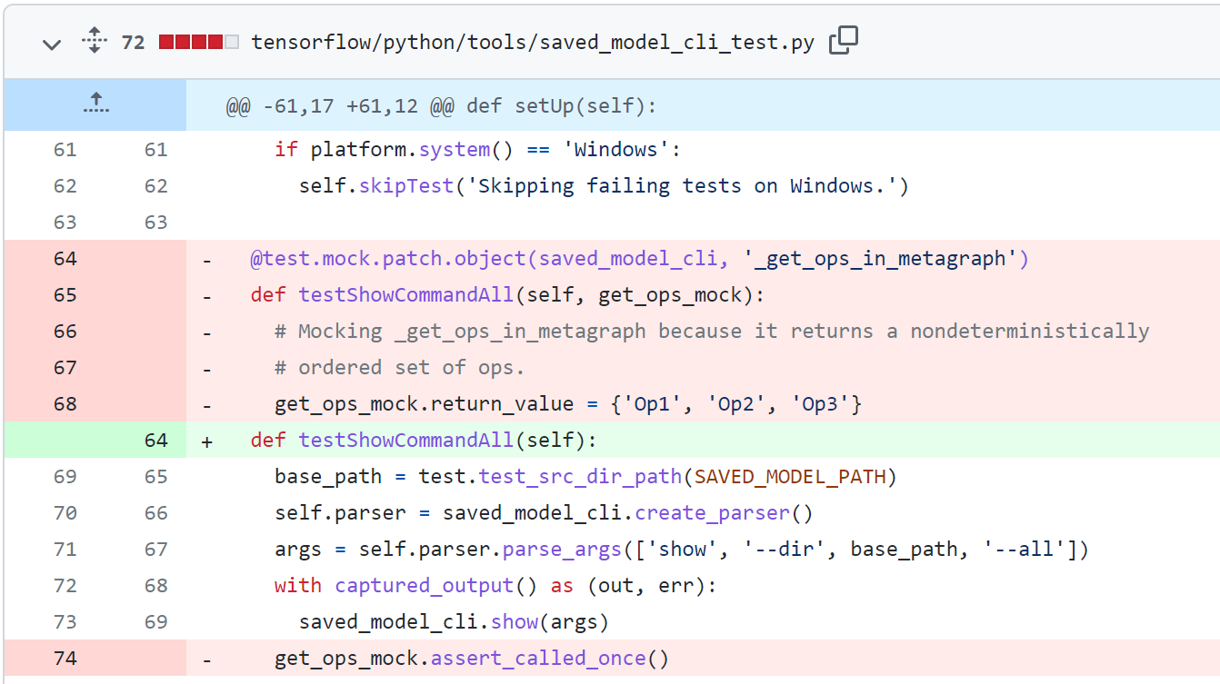
VCS enables line-by-line comparisons as you create new versions of a file
Notes:
Image – screensnip of https://github.com/tensorflow/tensorflow/commit/cc3a26b842f3d0c2cacb0253f73c1c30a9716367

Slide 7
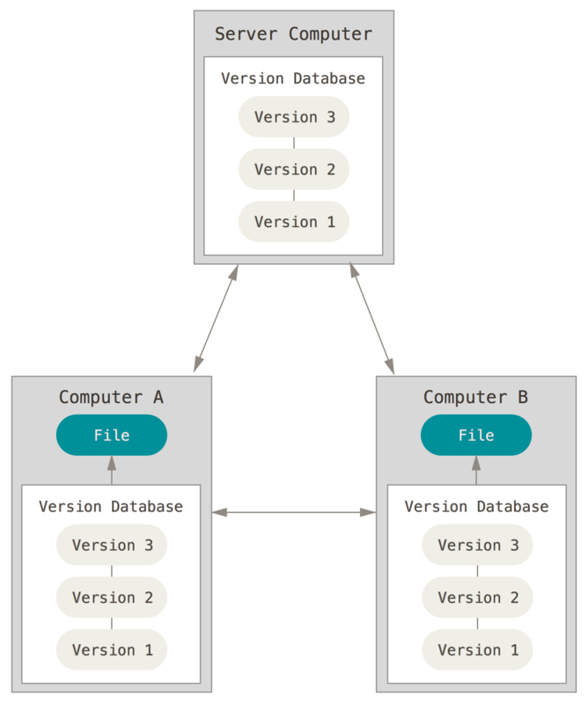
Distributed VCS enables remote collaboration and protects against data loss on the server

Slide 8
So why invest in learning and using a VCS?
Thesis
Group projects
Coursework
Provides better change management
Supports collaboration
Used in some DS & programming classes

Slide 9
Version control: Git & GitHub/GitLab
What is version control? Why use it?
Git & GitHub/GitLab
Hands-on activities

Slide 10
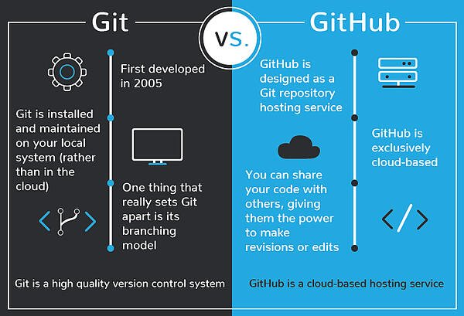
Git is a popular VCS, while GitHub is a cloud hosting service for Git
Notes:
Others exist, like SVN/Subversion and Mercurial, for VCS.
Alternatives to GitHub include GitLab (used by AFAC) and BitBucket
Even if you don’t personally use Git or GitHub for your own work, GitHub is a good resource for open-source code and examples, so some familiarity with it will be useful.
Image: https://blog.devmountain.com/git-vs-github-whats-the-difference/

Slide 11
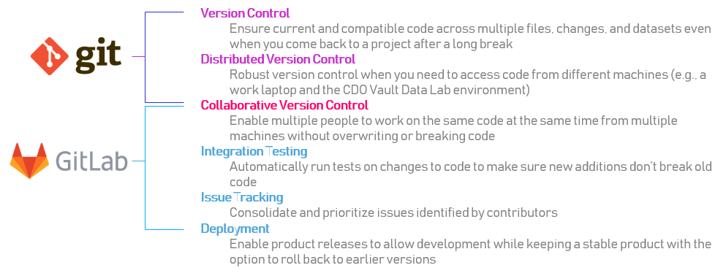
GitLab is essentially GitHub and is used by the DoD (https://gitlab.gs.mil/)
Notes:
Image from https://gitlab.gs.mil/afac/tutorials/git-orientation/-/blob/master/Part1/Introduction.md
GitLab has all the same features, just different presentations and sometimes different names for functions. It might be worth your time since AFAC uses it. One perk: integration with VAULT

Slide 12
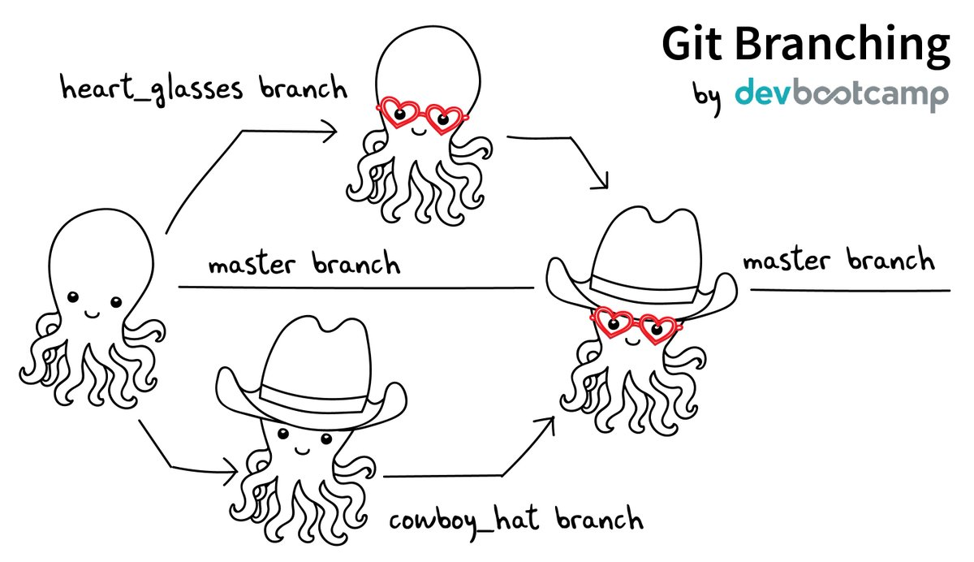
Git supports numerous workflows and branching strategies
Notes:
Image: https://coderefinery.github.io/git-intro/06-branches/

Slide 13
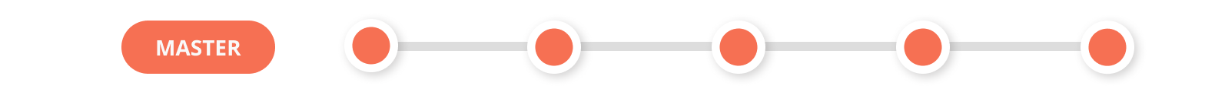
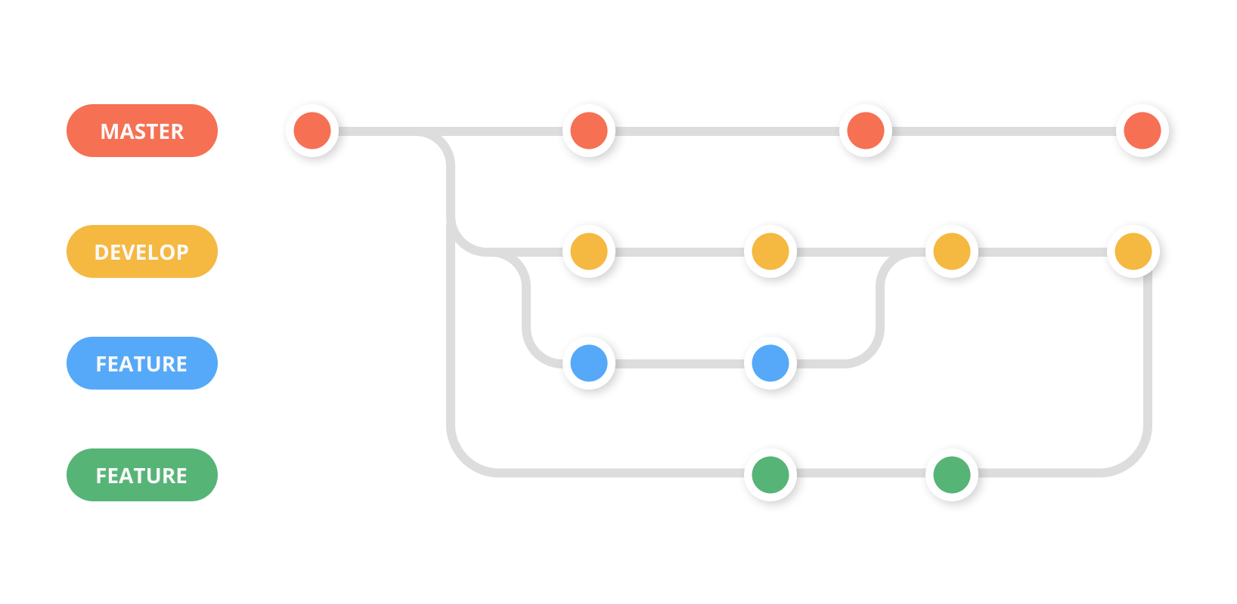
Notes:
Image: https://zepel.io/blog/5-git-workflows-to-improve-development/
Git command cheat sheet: https://www.atlassian.com/git/tutorials/atlassian-git-cheatsheet

Slide 14
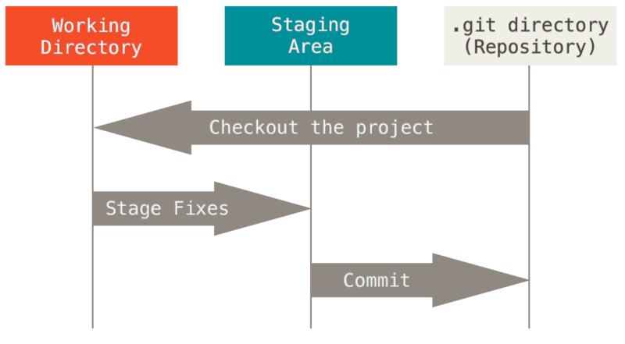
With Git, a file is modified, staged, or committed

Slide 15
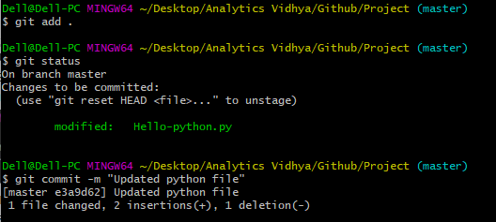
Typical flow: edit a file, stage it, then create a commit
Notes:
Image: https://www.analyticsvidhya.com/blog/2020/05/git-github-essential-guide-beginners/
There are GUIs for Git, but I say use the command line. Most examples out there use the command line, and getting more comfortable with it for Git and other things will make you a more effective computer user.

Slide 16
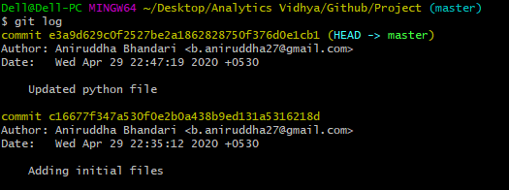
Using short, descriptive commit messages makes for a more useful log of commits
Notes:
Image: https://www.analyticsvidhya.com/blog/2020/05/git-github-essential-guide-beginners/

Slide 17
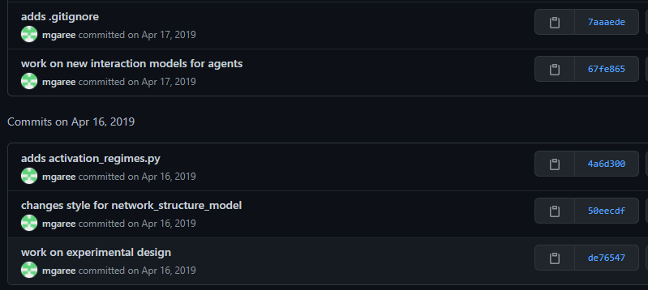
History on GitHub is basically the same
Notes:
Image: private repository
Being skilled at Git is more important than GitHub. You can use GitHub for nothing more than a remote copy of your repository and be just fine.

Slide 18
Show GitHub example
Notes:
Point out some of the general navigation features

Slide 19
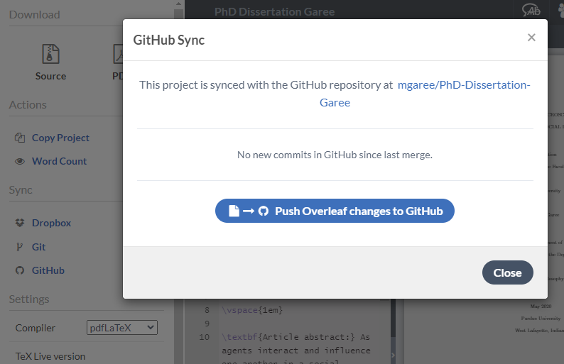
Version control: not just for coding
Notes:
Image: from my Overleaf account
Anyone use LaTeX before? Some of you may use it for thesis and other coursework.

Slide 20
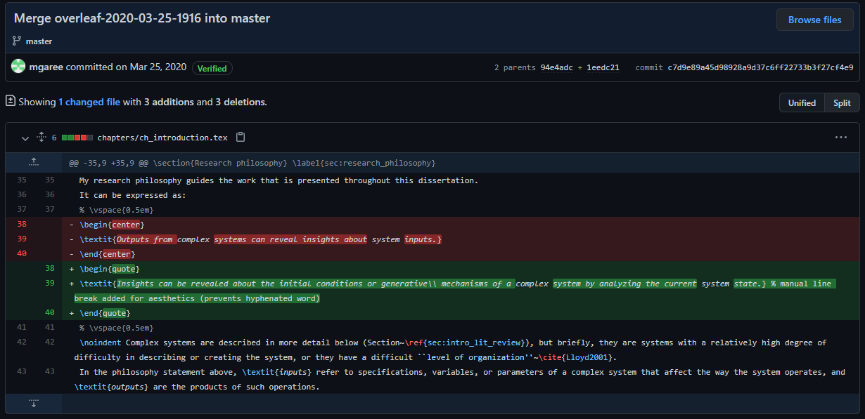
Detailed diff of a LaTeX source file as committed from Overleaf
Notes:
Image: private GitHub repository
You can put non-plain text files into Git as well, and should, if they’re part of a project. But you don’t get line-by-line features.
And even MS Word has some built-in version control via Track Changes, Compare, and an automatic version history. For more, https://www.howtogeek.com/school/microsoft-word-for-teams/lesson5/

Slide 21
Version control: Git & GitHub/GitLab
What is version control? Why use it?
Git & GitHub/GitLab
Hands-on activities

Slide 22
Prep work #1 – install Git
Mac users: git may already be installed; try
$ git --version
Anaconda users: conda install git from the Anaconda prompt
Or, get installer from Google or https://git-scm.com/downloads
Notes:
Demo opening Anaconda prompt, showing result of git --version; the $ indicates command prompt, don’t type it

Slide 23
Prep work #2 – configure Git
In the terminal (Mac terminal, Anaconda prompt, or GitBash terminal), do:
$ git --version
$ git config --global user.name “Your Name”
$ git config --global user.email “Your Email”
Use an email address you can access during this session
Include quotes!
Notes:
On email, GitHub requires email confirmation to enable all features, so only use @afit.edu if you can check that account now.

Slide 24
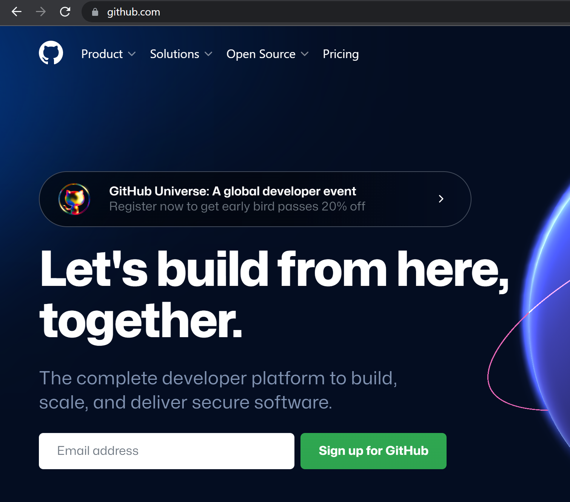
Prep work #3 – Goto github.com and create your account
Use same email address as from git config step

Slide 25
Prep work #4 – confirm GitHub account via activation email
You can use GitHub read-only without this, but activation enables read-write access
Notes:
Alternatively, if you have a CAC reader, try GitLab at https://gitlab.gs.mil – but due to time, I probably won’t demo GitLab
(FUTURE: have students create gitlab.gs.mil accounts before class and enable username/password access).

Slide 26
Prep work #5 – open a text editor
For today’s work, Notepad or TextEdit is fine
I like Notepad++. Atom is also great.
Or use a Python IDE – Spyder, Visual Studio Code, etc. VS Code is popular among past students

Slide 27
Prep work summary
$ conda install git (or find a downloader)
$ git --version
$ git config --global user.name “Your Name”
$ git config --global user.email “Your Email”
Goto https://github.com/ to create account using “Your Email”, then confirm email address (or https://gitlab.gs.mil for GitLab)
Open text editor of your choice (Notepad, Spyder, VS Code, …)

Slide 28
Task #1 – edit Readme in a new GitHub repository
Create new repository on GitHub
Create new file within repository, name it Readme.md, add some text, and commit it
Edit that file, commit those changes, and see that the changes have been saved
View the commit to see the changes (“diff”)
Notes:
Pause to let students try on their own, then demonstrate.

Slide 29
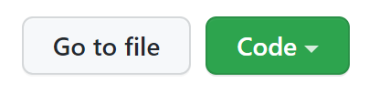
Task #2 – clone your new repository to your local machine and make changes
$ git log $ cd repo-name
Use $ git status often
Use your terminal to clone the repo check out the green Code button & HTTPS
Check the history of the project; you’ll need to change directory first
Make an edit in your text editor, save, stage the file, and commit it (locally) $ git commit -m “short description here”
Notes:
If someone doesn’t do the “-m <message>” they’ll get a unix text editor. To recover, type :q then enter to quit out of that editor and try again with the –m flag. (You *can* use that editor, but learning to work with Vi is out of scope.)

Slide 30
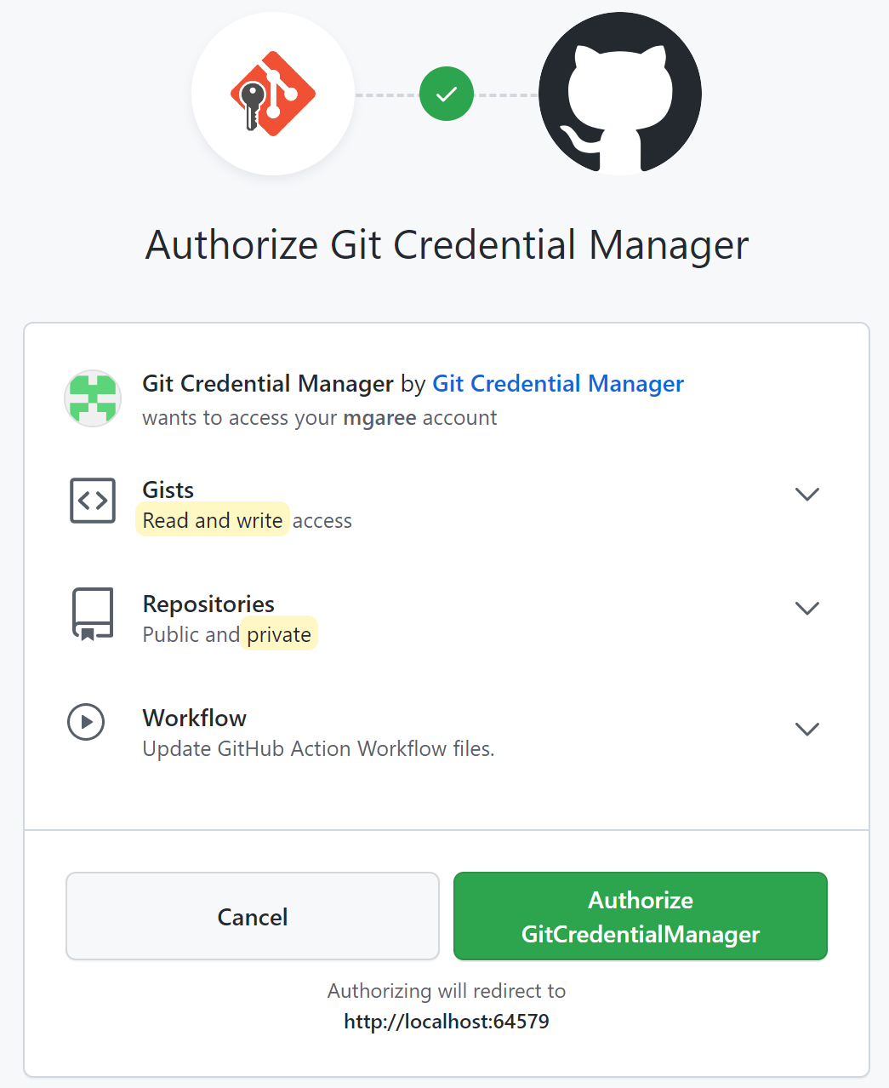
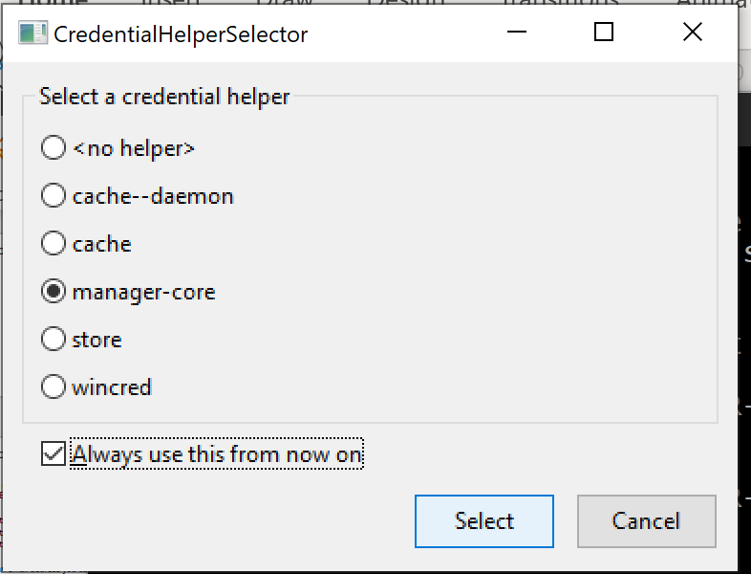
Task #3 – push your changes back to GitHub
$ git push
Sign in via browser
Notes:
I chose the default manager-core and “Always Use”, then sign in via Browser (a token is probably best practice but out of scope). May need to repeat the manager-core part after signing in. Can close the localhost browser window. Then refresh GitHub to see changes.
I don’t know what happens on a Mac.
SSH is “more secure” but HTTPS is good and what GitHub defaults to/recommends. HTTPS is also simpler. GitLab may require SSH due to .mil protections (go Edit Profile -> SSH Keys, and read the instructions). If you set a username/password for GitLab, then maybe HTTPS works? My testing didn’t.

Slide 31
Task #4 – create a new branch & a new file, then commit & push these changes
$ git checkout -b <new branch name> The -b combines creating & switching to it
When you go to push, there should be an error; it tells you the command to solve it
On GitHub, you’ll need to switch branches in order to view your latest creations

Slide 32
Task #5 – create a merge conflict between branches and resolve the merge successfully
Merge conflicts can arise when changes happen in the same lines in two branches So make that happen!
Switch branches: $ git checkout <branch> Compare branches: $ git diff <branch>
From main branch, $ git merge <new branch> Recommend use text editor to resolve conflict
Notes:
Recommend resolving the conflict in text editor. After the affected file is “clean”, a new commit is required. Usually –m “merged <branch> into <other branch>”

Slide 33
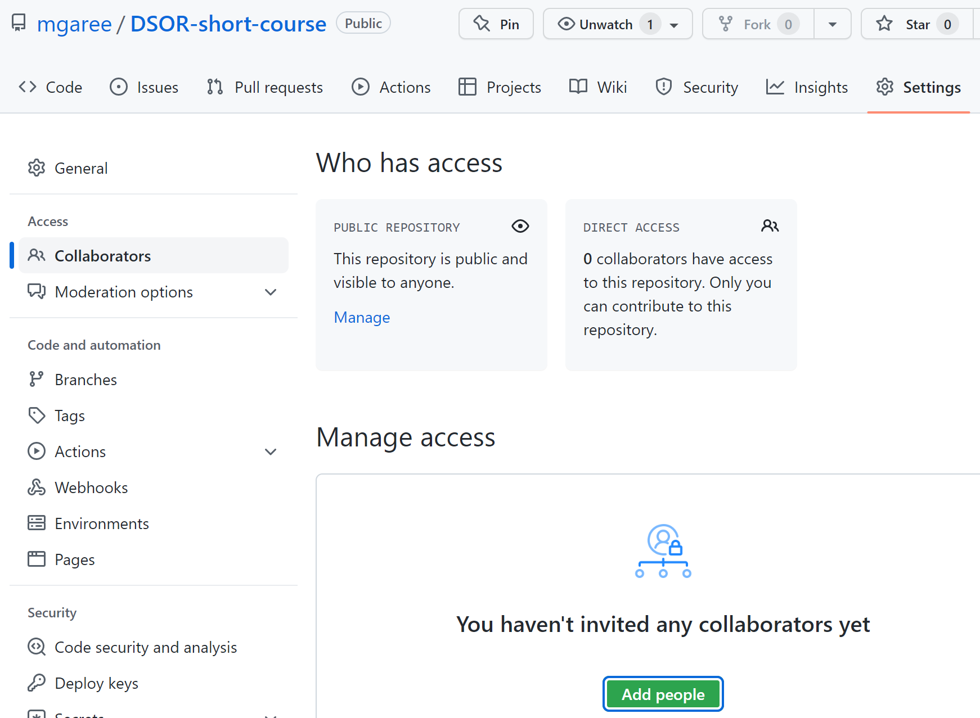



Task #6 – collaborate with a classmate; treat one of your repos as “the group project”
After gaining access, $ cd .., clone the group’s repo, make changes, commit, & push
Project owner: then pull down the new work
Notes:
Consider doing everything on the main branch for this task

Slide 34
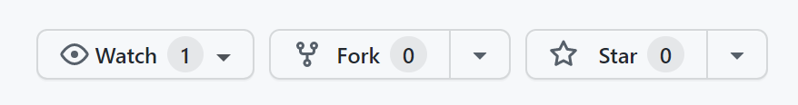
Task #7 – contribute to someone else’s project via forking and pull requests
To try fixing a Python bug (& getting these slides), use:
mgaree/DSOR-short-course
Fork the project – makes a copy into your own repositories
Clone, create a new branch, make changes, commit, & push to GitHub as usual
On GitHub, “Compare & pull request”
Notes:
The repo owner will have to review your pull request before it is actually merged.

Slide 35
A reasonable workflow for using Git for coursework
$ git init <name>
$ git add .
$ git status
$ git diff
$ git commit -m
Stay local unless you need the cloud support, and make your repos private if using GitHub Ensures you’re not sharing HW by mistake
If multiple HW problems, make a commit for each one; it’s fine to commit work in progress!
For longer projects, a daily commit can help you stay organized between work sessions

Slide 36
Pro tips – Git is quite friendly, but there’s a few edge cases that cause most of the pain
When pushing from more than one machine: commit locally, pull, & merge BEFORE push
If using branches, keep an eye on which branch you’re on before pushing
Stay well-organized and you’ll avoid most merge conflicts; if they happen, don’t panic
If you want to undo a commit, tread carefully; at first, it’s safest to just make a new commit
Notes:
There’s plenty of fancy things you can do and complicated branching and rebasing, but what we covered today is more than most folks will ever need. GitLab has all the same features, just maybe some different names and workflows.
There are GUI frontends for Git, but I recommend staying with the terminal. There is Git integration with most IDEs, so if that sounds appealing, research it and make it part of your workflow.

Slide 37
Version control: Git & GitHub/GitLab
What is version control? Why use it?
Git & GitHub/GitLab
Hands-on activities

Slide 38
Lesson objectives
Understand the value of version control software.
Use Git for basic version control operations.
Sync changes to a remote repository using GitHub.

Slide 39
Some resources
Git and GitHub for Beginners - Crash Course – YouTube
Learn Git in 15 minutes
https://github.com/mgaree/DSOR-short-course

